Slide 1

From Nand to Tetris
Building a Modern Computer from First Principles
Chapter 3
Memory
These slides support chapter 3 of the book
The Elements of Computing Systems
(1st and 2nd editions)
By Noam Nisan and Shimon Schocken
MIT Press

Slide 2
Usage Notice
You are welcome to use this presentation, or any part of it, in Nand to Tetris courses, or in other courses, as you see fit.
Usage is free provided that it supports instruction in educational, non-profit settings.
You can use the slides as-is, or modify them as needed.
We’ll appreciate it if you will credit Nand to Tetris somewhere, and put a reference to www.nand2tetris.org
Happy teaching!
Shimon Schocken / Noam Nisan

Slide 3
Nand to Tetris Roadmap: Hardware
abstraction
machine language
assembler
p6
hardware platform
abstraction
Building a computer
computer
abstraction
Building chips
p4
ALU, RAM
abstraction
Building gates
p5
p3
elementary logic gates
Nand
p2
p1

Slide 4
Nand to Tetris Roadmap: Hardware
abstraction
machine language
assembler
p6
hardware platform
abstraction
Building a computer
computer
abstraction
Building chips
p4
ALU, RAM
abstraction
Building gates
p5
p3
elementary logic gates
Nand
p2
p1
Project 1: Build basic logic gates
Project 2: Build the ALU

Slide 5
Nand to Tetris Roadmap: Hardware
abstraction
machine language
This lecture / chapter / project:
Build the computer’s Memory system
assembler
p6
hardware platform
abstraction
Building a computer
computer
abstraction
Building chips
p4
ALU, RAM
abstraction
Building gates
p5
p3
elementary logic gates
Nand
p2
p1
Project 1: Build basic logic gates
Project 2: Build the ALU

Slide 6
A common theme in computer science
We present a simple model (the simpler, the better)
We explore the model’s power:
What the model can do
What it cannot do
We then extend the model, to make it more powerful
Case in point:
Logic gates.

Slide 7
Logic gates
Model: And, Or, Not, …
Simple, and powerful:
Logic gates can realize any Boolean function, and can be combined to form powerful chips, like an ALU
But, as a general model of computation, logic gates fall short
Limitations
Logic gates cannot store information (bits) over time
Feedback loops are not allowed: A chip’s output cannot serve as its input
Logic gates can handle only inputs of a fixed size. For example, we can build an Or3 gate, and an Or4 gate, and so on, but we cannot build a single gate that computes Or for any given number of inputs
Extension
Allow logic gates to be sensitive to the progression of time.

Slide 8
Time-independent logic
So far we ignored time
The chip’s inputs were just “sitting there” – fixed and unchanging
The chip’s output was a function (“combination”) of the current inputs, and the current inputs only
+
0101
1101
ALU
1000

Slide 9
Time-independent logic
So far we ignored time
The chip’s inputs were just “sitting there” – fixed and unchanging
The chip’s output was a function (“combination”) of the current inputs, and the current inputs only
This style of gate logic is sometimes called:
time-independent logic
combinational logic
All the chips that we discussed and developed so far were combinational
+
0101
1101
ALU
1000
ALU: The “topmost” combinational chip

Slide 10
Hello, time

Slide 11
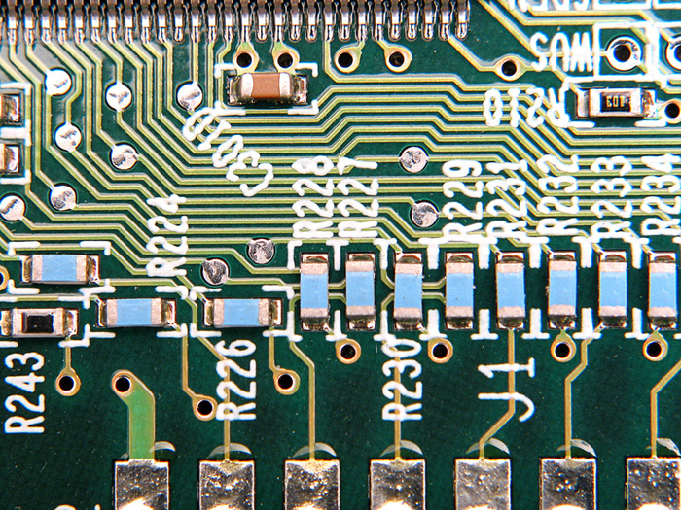
Hello, time
Software needs:
Example (variables):
The hardware must be able to remember things, over time:
x = 17
Example (iteration):
The hardware must be able to do things, one at a time (sequentially):
for i in range(0, 10):
print(i)
Hardware needs:
The hardware must handle the physical time delays associated with computing and moving data from one chip to another.

Slide 12
Hello, time
Software needs:
Example (variables):
The hardware must be able to remember things, over time:
x = 17
Example (iteration):
The hardware must be able to do things, one at a time (sequentially):
for i in range(0, 10):
print(i)
Hardware needs:
+
The hardware must handle the physical time delays associated with computing and moving data from one chip to another.
5
Now compute
7 + 11 ...
13
ALU
8
It will take some time before 7 and 11 will settle down in the input ports, and before the sum 7 + 11 will stabilize. Till then, the ALU will output nonsense.

Slide 13
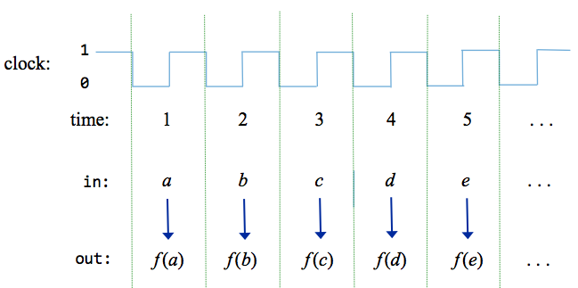
Hello, time
Solution: We can neutralize the time delays if we decide to use discrete time
cycle length
tick
Clock:
Clock:
tock
time-step:

Slide 14
Hello, time
Solution: We can neutralize the time delays if we decide to use discrete time
cycle length
tick
Clock:
Clock:
tock
time-step:
As it turns out, the clock can also be used to help implementing chips that behave like memory devices.
Chip’s input:
a
b
c
d
e
Chip’s output:
f(a)
f(b)
f(c)
f(d)
f(e)
Set the cycle length to be slightly > than the maximum time delay, and…
Decide to use the chips’s outputs only at the end of cycles (time-steps), ignoring what happens within cycles
Details later.

Slide 15
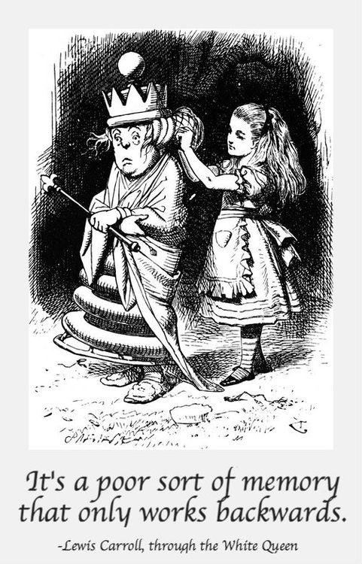
Memory
Memory: The faculty of the brain by which data or information is encoded, stored, and retrieved when needed.
It is the retention of information over time for the purpose of influencing future action (Wikipedia)
Memory is time-based:
We remember now what was committed to memory earlier.
Notes:
Talk about mathematical functions, and variables, and lack of time in math

Slide 16
Memory
load
Basic abstractions:
“Loading” a value
“Storing” a value
in
out
Register
16
16
time
1 2 3 4 5 6 7 205 206 207 208 209 210 211 ...
...
x = 17
, 17, 17, 17, 17, 17, 17, ... ,
(cycles)
loading
storing
, 21, 21, 21, 21, 21, 21, ...
x = 21
loading
storing
The challenge: Building chips that realize this functionality.
Notes:
Unlike the DFF, which remembers only the bit from the previous time unit.

Slide 17
Memory
RAM
0
Register
1
Register
Data
Flip-Flop
1-bit
register
multi-bit register
...
n-1
Register
?
Bit
Bit
...
Bit
DFF
DFF
Bit
Register
RAMn
The challenge: Building chips that realize this functionality.

Slide 18
Chapter 3: Memory
Abstraction
Representing time
Clock
Registers
RAM
Counters
Implementation
Data Flip Flop
Registers
RAM
Project 3: Chips
Project 3: Guidelines

Slide 19
Chapter 3: Memory
Abstraction
Representing time
Clock
Registers
RAM
Counters
Implementation
Data Flip Flop
Registers
RAM
Project 3: Chips
Project 3: Guidelines

Slide 20
Representing time
physical time:
Arrow of time:
Continuous

Slide 21
Representing time
physical time:
Arrow of time:
Continuous
clock:
1
0

Slide 22
Representing time
physical time:
Arrow of time:
Continuous
clock:
1
Discrete time:
Design decision: Track state changes only when advancing from one time-step to another
0
time: 1 2 3 4 5 . . .

Slide 23
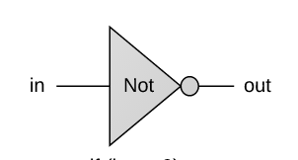
Chip behavior over time (example: Not gate)
physical time:
Arrow of time:
Continuous
clock:
1
Discrete time:
Design decision: Track state changes only when advancing from one time-step to another
0
time: 1 2 3 4 5 . . .
in:
(arbitrary values)
in:
1
0
out:
(Not(in))
1
0
(example)

Slide 24
Chip behavior over time (example: Not gate)
physical time:
Arrow of time:
Continuous
clock:
1
Discrete time:
Design decision: Track state changes only when advancing from one time-step to another
0
time: 1 2 3 4 5 . . .
in:
(arbitrary values)
1
0
out:
(Not(in))
1
0
(example)
Desired / idealized behavior of the in and out signals:
That’s how we want the hardware to behave

Slide 25
Chip behavior over time (example: Not gate)
physical time:
Arrow of time:
Continuous
clock:
1
Discrete time:
Design decision: Track state changes only when advancing from one time-step to another
0
time: 1 2 3 4 5 . . .
in:
(arbitrary values)
1
0
out:
(Not(in))
1
0
(example)
Actual behavior of the in and out signals:
Influenced by physical time delays

Slide 26
Chip behavior over time (example: Not gate)
physical time:
Arrow of time:
Continuous
clock:
1
Discrete time:
Design decision: Track state changes only when advancing from one time-step to another
0
time: 1 2 3 4 5 . . .
in:
(arbitrary values)
1
0
out:
(Not(in))
1
0
(example)
Time delays
Propagation delays
Computation delays
Cycle length

Slide 27
Chip behavior over time (example: Not gate)
physical time:
Arrow of time:
Continuous
clock:
1
Discrete time:
Design decision: Track state changes only when advancing from one time-step to another
0
time: 1 2 3 4 5 . . .
in:
(arbitrary values)
1
0
out:
(Not(in))
1
0
(example)
Time delays
Propagation delays
Computation delays
Cycle length
Design parameter
Set to be slightly > max(time delays)

Slide 28
Chip behavior over time (example: Not gate)
physical time:
Arrow of time:
Continuous
clock:
1
Discrete time:
Design decision: Track state changes only when advancing from one time-step to another
0
time: 1 2 3 4 5 . . .
in:
(arbitrary values)
1
0
out:
(Not(in))
1
0
(example)
Resulting effect:
Combinational chips react “immediately” to their inputs
Facilitated by the decision to track changes only at cycle ends

Slide 29

Chapter 3: Memory
Abstraction
Representing time
Clock
Registers
RAM
Counters
Implementation
Data Flip Flop
Registers
RAM
Project 3: Chips
Project 3: Guidelines

Slide 30
Clock

Slide 31
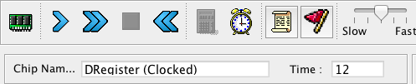
Clock: Simulated implementation
Interactive simulation
A clock icon can be used to generate a sequence of tick-tock signals: 0, 0+, 1, 1+, 2, 2+, 3, 3+, ...

Slide 32
Clock: Simulated implementation
Interactive simulation
A clock icon can be used to generate a sequence of tick-tock signals: 0, 0+, 1, 1+, 2, 2+, 3, 3+, ...
Script-based simulation
“tick” and “tock” commands can be used to advance the clock:
...
// Sets inputs, advances the clock, and
// writes output values as it goes along.
set in 19,
set load 1,
tick,
output,
tock,
output,
tick, tock,
output,
...

Slide 33
Clock: Physical implementation
Physical clock
An oscillator is used to deliver an ongoing train of “tick/tock” signals
“1 MHz electronic oscillator circuit which uses the resonant properties of an internal quartz crystal to control the frequency. Provides the clock signal for digital devices such as computers.” (Wikipedia)
The oscillator’s output is connected to all the time-based (clocked) chips in the computer
Chip diagram convention:
A triangle icon represents a clock signal input

Slide 34
Chapter 3: Memory
Abstraction
Representing time
Clock
Registers
RAM
Counters
Implementation
Data Flip Flop
Registers
RAM
Project 3: Chips
Project 3: Guidelines

Slide 35
Combinational logic / Sequential logic

Slide 36
Combinational logic / Sequential logic
Combinational logic:
The output depends on the current inputs
The clock is used to stabilize outputs

Slide 37
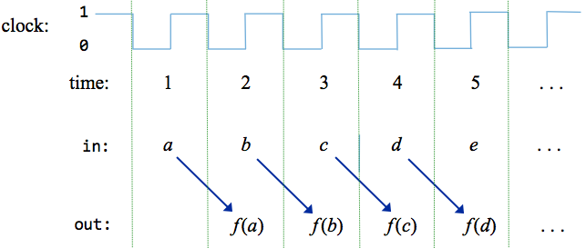
Combinational logic / Sequential logic
Combinational logic:
The output depends on the current inputs
The clock is used to stabilize outputs
Sequential logic:
The output depends on:
Previous inputs
Current inputs (optionally)
This behavior can be used to build chips designed to maintain state: Registers.
f(a,b)
f(b,c)
f(c,d)
f(d,e)

Slide 38
Registers
Memory
(many registers)
CPU
Input
ALU
Output
Registers
(a few)
Computer Architecture

Slide 39
Registers
load
load
in
out
in
out
Bit
Register
w
w
1-bit register
multi-bit register
Designed to:
“Store” / “remember” / “maintain” / “persist” a value , until...
“Instructed” to “load”, and then “store”, another value.
time:
x = 17, 17, 17, 17, 17, 17, 17, ..., 17
x = 21, 21, 21, 21, 21, 21, ..., 21
loading
maintaining state
loading
maintaining state
Notes:
Unlike the DFF, which remembers only the bit from the previous time unit.

Slide 40
1-Bit Register
load
in
Bit
out
if load(t – 1) then out(t ) = in(t – 1)
else out(t) = out(t – 1)
time:
1
2
3
4
5
6
7
8
1
load:
0
1
in:
0
1
out:
0

Slide 41
1-Bit Register
load
in
Bit
out
if load(t – 1) then out(t ) = in(t – 1)
else out(t) = out(t – 1)
time:
1
2
3
4
5
6
7
8
1
load:
examples of arbitrary input values
0
1
in:
0
1
out:
0

Slide 42
1-Bit Register
load
in
Bit
out
if load(t – 1) then out(t ) = in(t – 1)
else out(t) = out(t – 1)
time:
1
2
3
4
5
6
7
8
1
load:
examples of arbitrary input values
0
1
in:
0
1
out:
0

Slide 43
1-Bit Register
load
in
Bit
out
if load(t – 1) then out(t ) = in(t – 1)
else out(t) = out(t – 1)
time:
1
2
3
4
5
6
7
8
1
load:
examples of arbitrary input values
0
1
in:
0
1
out:
0

Slide 44
1-Bit Register
load
in
Bit
out
if load(t – 1) then out(t ) = in(t – 1)
else out(t) = out(t – 1)
time:
1
2
3
4
5
6
7
8
1
load:
examples of arbitrary input values
0
1
in:
0
1
out:
0

Slide 45
1-Bit Register
load
in
Bit
out
if load(t – 1) then out(t ) = in(t – 1)
else out(t) = out(t – 1)
time:
1
2
3
4
5
6
7
8
1
load:
examples of arbitrary input values
0
1
in:
0
1
out:
0

Slide 46
1-Bit Register
load
in
Bit
out
if load(t – 1) then out(t ) = in(t – 1)
else out(t) = out(t – 1)
time:
1
2
3
4
5
6
7
8
1
load:
examples of arbitrary input values
0
1
in:
0
1
out:
0

Slide 47
1-Bit Register
load
in
Bit
out
if load(t – 1) then out(t ) = in(t – 1)
else out(t) = out(t – 1)
time:
1
2
3
4
5
6
7
8
1
load:
examples of arbitrary input values
0
1
in:
0
1
out:
0

Slide 48
1-Bit Register
load
in
Bit
out
if load(t – 1) then out(t ) = in(t – 1)
else out(t) = out(t – 1)
time:
1
2
3
4
5
6
7
8
1
load:
examples of arbitrary input values
0
1
in:
0
1
out:
0

Slide 49
1-Bit Register
load
in
Bit
out
if load(t – 1) then out(t ) = in(t – 1)
else out(t) = out(t – 1)
time:
1
2
3
4
5
6
7
8
1
load:
examples of arbitrary input values
0
1
in:
0
1
out:
0
“storing”
“loading”
“storing”
Resulting behavior:
“loading”

Slide 50
1-Bit Register
load
in
Bit
out
if load(t – 1) then out(t ) = in(t – 1)
else out(t) = out(t – 1)
Usage:
To read:
probe out
(out always emits the register’s state)
To write:
set in = v
set load = 1
Result: The register’s state becomes v; From the next time-step onward, out will emit v

Slide 51
Multi-bit Register
load
in
out
if load(t – 1) then out(t ) = in(t – 1)
else out(t) = out(t – 1)
Register
w
w
We’ll focus on word width w = 16, without loss of generality
Load / store behavior: Exactly the same as a 1-bit register
Read / write usage: Exactly the same as a 1-bit register

Slide 52
Chapter 3: Memory
Abstraction
Representing time
Clock
Registers
RAM
Counters
Implementation
Data Flip Flop
Registers
RAM
Project 3: Chips
Project 3: Guidelines

Slide 53
Computer architecture
Memory
(RAM)
CPU
Input
ALU
Output
Registers

Slide 54
RAM
RAMn
0
Register
1
Register
...
n-1
Register
Abstraction: A sequence of n addressable, w-bit registers, with addresses 0 to n-1
Word width: Typically 16, 32, 64 bits (Hack computer: w = 16)

Slide 55
RAM
load
RAMn
in
0
Register
Practice question:
Suppose that the RAM size n = 8 registers.
What should be the value of k?
w
out
1
Register
address
w
k
...
Answer:
k = log₂n
n-1
Register
Abstraction: A sequence of n addressable, w-bit registers, with addresses 0 to n-1
Word width: Typically 16, 32, 64 bits (Hack computer: w = 16)

Slide 56
RAM
load
RAMn
Behavior
in
0
Register
If load == 0, the RAM maintains its state
If load == 1, RAM[address] is set to the value of in
The loaded value will be emitted by out from the next time-step (cycle) onward, until the next load
w
out
1
Register
address
w
k
...
)Only one RAM register is selected; All the other registers are not affected(
n-1
Register
Usage:
To read register i :
set address = i,
probe out
(out always emits the value of RAM[i])
To write v in register i :
set address = i,
set in = v,
set load = 1
Result: RAM[i] ← v
From the next time-step onward, out will emit v

Slide 57
RAM
load
RAMn
in
0
Register
Why “Random Access Memory”?
Irrespective of the RAM size (n), every randomly selected register can be accessed “instantaneously”, at more or less the same speed.
w
out
1
Register
address
w
k
...
n-1
Register

Slide 58
Chapter 3: Memory
Abstraction
Representing time
Clock
Registers
RAM
Counters
Implementation
Data Flip Flop
Registers
RAM
Project 3: Chips
Project 3: Guidelines

Slide 59
Computer architecture
Memory
CPU
Input
ALU
Output
Registers
One of the CPU registers acts as a “program counter”

Slide 60
Counter
Later in the course (chapter 5), we will see that the computer must keep track of which instruction should be fetched and executed next
This task is regulated by a register typically called Program Counter
We’ll use the PC to store the address of the instruction that should be fetched and executed next

Slide 61
Counter
Later in the course (chapter 5), we will see that the computer must keep track of which instruction should be fetched and executed next
This task is regulated by a register typically called Program Counter
We’ll use the PC to store the address of the instruction that should be fetched and executed next
The PC should support three abstractions:
Reset: fetch the first instruction
Next: fetch the next instruction
Goto: fetch instruction n
PC = 0
PC++
PC = n

Slide 62
Counter
load
inc
reset
if reset(t) out(t + 1) = 0
else if load(t) out(t + 1) = in(t)
else if inc(t) out(t + 1) = out(t) + 1
else out(t + 1) = out(t)
in
out
16
PC (counter)
16

Slide 63
Counter
load
inc
reset
if reset(t) out(t + 1) = 0
else if load(t) out(t + 1) = in(t)
else if inc(t) out(t + 1) = out(t) + 1
else out(t + 1) = out(t)
in
out
16
PC (counter)
16
Usage:
To read:
probe out
To set:
set in to v,
assert load,
set the other control bits to 0
To reset:
assert reset,
set the other control bits to 0
To count:
assert inc,
set the other control bits to 0

Slide 64
Chapter 3: Memory
Abstraction
Representing time
Clock
Registers
RAM
Counters
Implementation
Data Flip Flop
Registers
RAM
Project 3: Chips
Project 3: Guidelines

Slide 65
Chapter 3: Memory
Abstraction
Representing time
Clock
Registers
RAM
Counters
Implementation
Data Flip Flop
Registers
RAM
Project 3: Chips
Project 3: Guidelines

Slide 66
DFF
Data Flip Flop (aka latch)
The most elementary sequential gate: Outputs the input in the previous time-step
in
DFF
out
out(t) = in(t – 1)
time:
1
2
3
4
5
6
7
8
examples of arbitrary inputs
in:
1
0
out:
1
0

Slide 67
DFF
Data Flip Flop (aka latch)
The most elementary sequential gate: Outputs the input in the previous time-step
in
DFF
out
out(t) = in(t – 1)
time:
1
2
3
4
5
6
7
8
examples of arbitrary inputs
in:
1
0
out:
1
0

Slide 68
DFF
Data Flip Flop (aka latch)
The most elementary sequential gate: Outputs the input in the previous time-step
in
DFF
out
out(t) = in(t – 1)
time:
1
2
3
4
5
6
7
8
examples of arbitrary inputs
in:
1
0
out:
1
0

Slide 69
DFF
Data Flip Flop (aka latch)
The most elementary sequential gate: Outputs the input in the previous time-step
in
DFF
out
out(t) = in(t – 1)
time:
1
2
3
4
5
6
7
8
examples of arbitrary inputs
in:
1
0
out:
1
0

Slide 70
DFF
Data Flip Flop (aka latch)
The most elementary sequential gate: Outputs the input in the previous time-step
in
DFF
out
out(t) = in(t – 1)
time:
1
2
3
4
5
6
7
8
examples of arbitrary inputs
in:
1
0
out:
1
0

Slide 71
DFF
Data Flip Flop (aka latch)
The most elementary sequential gate: Outputs the input in the previous time-step
in
DFF
out
out(t) = in(t – 1)
time:
1
2
3
4
5
6
7
8
examples of arbitrary inputs
in:
1
0
out:
1
0

Slide 72
DFF
Data Flip Flop (aka latch)
The most elementary sequential gate: Outputs the input in the previous time-step
in
DFF
out
out(t) = in(t – 1)
time:
1
2
3
4
5
6
7
8
examples of arbitrary inputs
in:
1
0
out:
1
0

Slide 73
DFF
Data Flip Flop (aka latch)
The most elementary sequential gate: Outputs the input in the previous time-step
in
DFF
out
out(t) = in(t – 1)
time:
1
2
3
4
5
6
7
8
examples of arbitrary inputs
in:
1
0
out:
1
0

Slide 74
From DFF to a 1-bit register
Data Flip Flop (aka latch)
The most elementary sequential gate: Outputs the input in the previous time-step
in
DFF
out
out(t) = in(t – 1)
time:
1
2
3
4
5
6
7
8
examples of arbitrary inputs
in:
1
0
out:
1
0
How can we “load” and then “maintain” a value (0 or 1) over time, without having to feed the value in every cycle?

Slide 75
From DFF to a 1-bit register
in
DFF
out
out(t) = in(t – 1)
We have to realize a “loading” behavior and a ”storing” behavior, and be able to select between these two states
How can we “load” and then “maintain” a value (0 or 1) over time, without having to feed the value in every cycle?

Slide 76
From DFF to a 1-bit register
load
1-bit Register
Stores one bit over time
if load(t – 1) then
out(t ) = in(t – 1)
else
out(t) = out(t – 1)
in
DFF
out
We have to realize a “loading” behavior and a ”storing” behavior, and be able to select between these two states
Behavior
if load == 1 the register’s value becomes in
else the register maintains its current value

Slide 77
Register
load
1-bit Register
Stores one bit over time
if load(t – 1) then
out(t ) = in(t – 1)
else
out(t) = out(t – 1)
Bit
DFF
in
out

Slide 78
Register
1-bit Register
Stores one bit over time
load
if load(t – 1) then
out(t ) = in(t – 1)
else
out(t) = out(t – 1)
in
out
zoom out...

Slide 79
Register
1-bit Register
Stores one bit over time
load
if load(t – 1) then
out(t ) = in(t – 1)
else
out(t) = out(t – 1)
in
out
load
w-bit Register:
Stores w bits over time
in
out
...
w
w
Partial diagram, showing some of the chip-parts, without connections

Slide 80
Chapter 3: Memory
Abstraction
Representing time
Clock
Registers
RAM
Counters
Implementation
Data Flip Flop
Registers
RAM
Project 3: Chips
Project 3: Guidelines

Slide 81
Memory hierarchy
Random Access Memory
0
Register
1
Register
Data
Flip-Flop
1-bit
register
16-bit register
...
n-1
Register
?
Bit
Bit
...
Bit
DFF
DFF
Bit
Register
RAMn

Slide 82
Memory hierarchy
Random Access Memory
0
Register
1
Register
Data
Flip-Flop
1-bit
register
16-bit register
...
n-1
Register
?
Bit
Bit
...
Bit
DFF
DFF
Bit
Register
RAMn

Slide 83
RAM: Abstraction
RAM of n registers:
Usage:
To read register i :
set address = i,
probe out
(out always emits the state of RAM[i])
To write v in register i :
set address = i,
set in = v,
set load = 1
Result: RAM[i] ← v
From the next time-step onward, out emits v

Slide 84
RAM: Implementation
RAM of n registers:
Partial diagram, showing some of the chip-parts, without connections
load
in
out
Register
w
w
in
w
load
in
out
Register
out
load
w
w
w
address
...
load
k
in
out
Register
w
w

Slide 85
RAM: Implementation
RAM of n registers:
Partial diagram, showing some of the chip-parts, without connections
load
in
out
Register
w
w
in
w
load
in
out
Register
out
load
w
w
Mux
(n to 1)
w
address
...
load
k
in
out
Register
w
w
Reading: Can be realized using a Mux

Slide 86
RAM: Implementation
RAM of n registers:
Partial diagram, showing some of the chip-parts, without connections
load
in
out
Register
w
w
in
w
load
in
out
Register
out
load
DMux
(1 to n)
w
w
Mux
(n to 1)
w
address
...
load
k
in
out
Register
w
w
Reading: Can be realized using a Mux
Connections?
You figure it out
Writing: Can be realized using a DMux

Slide 87
RAM: Implementation
RAM of n registers:
Partial diagram, showing some of the chip-parts, without connections
load
in
out
Register
w
w
in
w
load
in
out
Register
out
load
DMux
(1 to n)
w
w
Mux
(n to 1)
w
address
...
load
k
in
out
Register
w
w
Observations
The addressing/selection/reading logic is combinational
The writing logic is (i) sequential (clocked)
(ii) embedded in the Register logic.

Slide 88
RAM: Implementation
RAM512
RAM64
RAM64
…
RAM8
RAM64
RAM8
RAM8
Register
...
Register
...
Same technique can be used to implement RAM devices of any size
...
RAM64
Register
RAM8

Slide 89
Hack RAM
load
A family of 16-bit RAM chips:
RAMn
chip name | n | k
RAM8 | 8 | 3
RAM64 | 64 | 6
RAM512 | 512 | 9
RAM4K | 4096 | 12
RAM16K | 16384 | 14
in
0
Register
16
1
Register
out
address
16
k
...
n-1
Register
Why these particular RAM chips?
Because that’s what we need for building the Hack computer.
Notes:
Albert Einstein about achieving maximum functionality with minimum rules.

Slide 90
Chapter 3: Memory
Abstraction
Representing time
Clock
Registers
RAM
Counters
Implementation
Data Flip Flop
Registers
RAM
Project 3: Chips
Project 3: Guidelines

Slide 91
Project 3
Given:
All the chips built in projects 1 and 2
Data Flip-Flop (built-in DFF gate)
Why is the DFF built-in?
Build:
Bit
Register
PC
RAM8
RAM64
RAM512
RAM4K
RAM16K
Teaching note:
It is quite possible to skip completely the discussion of “Why the DFF is built-in” and the subsequent “DFF Implementation” slides.

Slide 92
DFF implementation
Given:
All the chips built in projects 1 and 2
Data Flip-Flop (built-in DFF gate)
Why is the DFF built-in?
/** Data Flip-flop: out(t) = in(t-1)
* where t is the current time unit. */
CHIP DFF {
IN in;
OUT out;
BUILTIN DFF;
CLOCKED in;
}

Slide 93
DFF implementation
The DFF gate logic implementation requires, among other things, connecting Nand gates with feedback loops
Part of a possible DFF implementation
/** Data Flip-flop: out(t) = in(t-1)
* where t is the current time unit. */
CHIP DFF {
IN in;
OUT out;
BUILTIN DFF;
CLOCKED in;
}

Slide 94
DFF implementation
The DFF gate logic implementation requires, among other things, connecting Nand gates with feedback loops
The resulting implementation is elegant, yet impossible to realize on the supplied hardware simulator:
The hardware simulator does not allow loops of combinational chips (like Nand)
Part of a possible DFF implementation
/** Data Flip-flop: out(t) = in(t-1)
* where t is the current time unit. */
CHIP DFF {
IN in;
OUT out;
BUILTIN DFF;
CLOCKED in;
}

Slide 95
DFF implementation
The DFF gate logic implementation requires, among other things, connecting Nand gates with feedback loops
The resulting implementation is elegant, yet impossible to realize on the supplied hardware simulator
The hardware simulator does not allow loops of combinational chips (like Nand)
Therefore, we will use a built-in DFF implementation:
Part of a possible DFF implementation
/** Data Flip-flop: out(t) = in(t-1)
* where t is the current time unit. */
CHIP DFF {
IN in;
OUT out;
BUILTIN DFF;
CLOCKED in;
}

Slide 96
Project 3
Given:
All the chips built in projects 1 and 2
Data Flip-Flop (built-in DFF gate)
Build:
Bit
Register
PC
RAM8
RAM64
RAM512
RAM4K
RAM16K

Slide 97
1-bit Register
Bit.hdl
/** 1-bit register:
if load(t – 1) then out(t) = in(t – 1)
else out(t) = out(t – 1)) */
CHIP Bit {
IN in, load;
OUT out;
PARTS:
// Put your code here:
}
load
in
Bit
out
load
Implementation tip:
Follow the chip diagram
in
out

Slide 98
16-bit Register
Register.hdl
/** 1-bit register:
if load(t – 1) then out(t) = in(t – 1)
else out(t) = out(t – 1)) */
CHIP Bit {
IN in[16], load;
OUT out[16];
PARTS:
// Put your code here:
}
load
in
out
Register
16
16
load
in
out
Implementation tip:
Follow the chip diagram
...
16
16
Partial diagram, showing some of the chip-parts, without connections

Slide 99
16-bit Counter
load
inc
reset
/**
A 16-bit counter with control bits.
if reset(t – 1) out(t) = 0 // resetting
else if load(t – 1) out(t) = in(t – 1) // setting
else if inc(t – 1) out(t) = out(t – 1) + 1 // incrementing
else out(t) = out(t – 1) // maintaining
*/
CHIP PC {
IN in[16], load, inc, reset;
OUT out[16];
PARTS:
// Put your code here:
}
in
out
16
PC (counter)
16
Implementation tip: Can be built from a Register, an Incrementer, and Mux’s

Slide 100
Project 3
Given
All the chips built in projects 1 and 2
Data Flip-Flop (built-in DFF gate)
Build the following chips
Bit
Register
PC
RAM8
RAM64
RAM512
RAM4K
RAM16K

Slide 101
8-Register RAM: Abstraction
load
RAM8.hdl
/*
Let M stand for the state of the register
selected by address.
if load(t – 1) then {M = in(t), out(t) = M}
else out(t) = M
*/
CHIP RAM8 {
IN in[16], load, address[3];
OUT out[16];
PARTS:
// Put your code here:
}
RAMn
in
Register
16
Register
out
address
16
3
...
Register

Slide 102
8-Register RAM: Implementation
load
in
out
Register
16
16
in
16
load
in
out
Register
out
load
DMux
(1 to 8)
16
16
Mux
(8 to 1)
16
address
...
load
3
in
out
Register
16
16
Partial diagram, showing some of the chip-parts, without connections
Implementation tip:
Follow the chip diagram

Slide 103
Project 3
Given
All the chips built in projects 1 and 2
Data Flip-Flop (built-in DFF gate)
Build the following chips
Bit
Register
PC
RAM8
RAM64
RAM512
RAM4K
RAM16K
A family of RAM chips

Slide 104
n-Register RAM
load
RAMn.hdl
/*
Let M stand for the state of the register
selected by address.
if load(t – 1) then {M = in(t), out(t) = M}
else out(t) = M
*/
CHIP RAMn {
IN in[16], load, address[k];
OUT out[16];
PARTS:
// Put your code here:
}
RAMn
in
Register
16
Register
out
address
16
k
...
Register
Notes:
Albert Einstein about achieving maximum functionality with minimum rules.

Slide 105
n-Register RAM
load
chip name | n | k
RAM8 | 8 | 3
RAM64 | 64 | 6
RAM512 | 512 | 9
RAM4K | 4096 | 12
RAM16K | 16384 | 14
RAMn
in
Register
16
Register
out
address
16
k
...
Register
Implementation tips
Think about the RAM’s address input as consisting of two fields:
One field selects a RAM-part;
The other field selects a register within that RAM-part
Use logic gates to effect this addressing scheme.
Notes:
Albert Einstein about achieving maximum functionality with minimum rules.

Slide 106
Chapter 3: Memory
Abstraction
Representing time
Clock
Registers
RAM
Counters
Implementation
Data Flip Flop
Registers
RAM
Project 3: Chips
Project 3: Guidelines

Slide 107
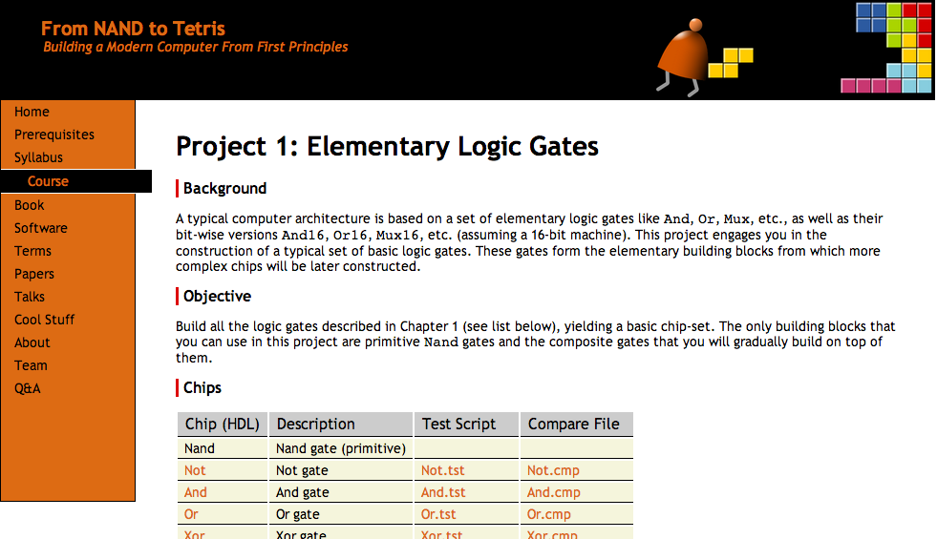
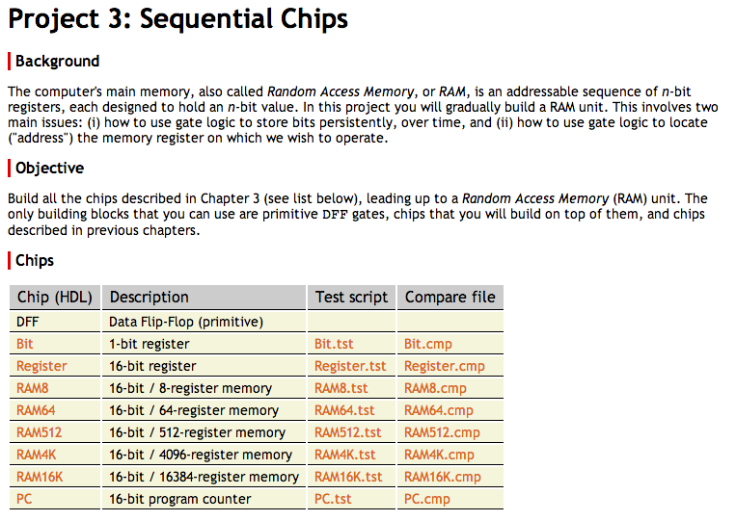
Project 3
www.nand2tetris.org
All the necessary project 3 files are available in:
nand2tetris / projects / 03

Slide 108
Resources
Project 3 folder (.hdl, .tst, .cmp files): nand2tetris/projects/03
Tools
Text editor (for completing the given .hdl stub-files)
Hardware simulator: nand2tetris/tools
Guides
Hardware Simulator Tutorial
HDL Guide
Hack Chip Set API

Slide 109
Best practice advice
Implement the chips in the order in which they appear in the project guidelines
If you don’t implement some chips, you can still use their built-in implementations
No need for “helper chips”: Implement / use only the chips we specified
In each chip definition, strive to use as few chip-parts as possible
You will have to use chips implemented in previous projects;
For efficiency and consistency’s sake, use their built-in versions, rather than your own HDL implementations.
For technical reasons, the chips of project 3 are organized in two sub-folders named projects/03/a and projects/03/b
When writing and simulating the .hdl files, leave this folder structure as is.
That’s It!
Go Do Project 3!

Slide 110
Chapter 3: Memory
Abstraction
Representing time
Clock
Registers
RAM
Counters
Implementation
Data Flip Flop
Registers
RAM
Project 3: Chips
Project 3: Guidelines

Slide 111
What’s next?
abstraction
machine language
assembler
p6
hardware platform
abstraction
Building a computer
computer
abstraction
Building chips
p4
ALU, RAM
abstraction
Building gates
p5
p2
elementary logic gates
Nand
p3
p1
This lecture / chapter / project:
Build the computer’s RAM

Slide 112
What’s next?
abstraction
machine language
assembler
p6
hardware platform
abstraction
Building a computer
computer
abstraction
Building chips
p4
ALU, RAM
abstraction
Building gates
p5
p2
elementary logic gates
Nand
p3
p1
Next lecture / chapter / project:
Get acquainted with the computer architecture
Write machine language programs

